Slide 1
RLP Installation

Slide 2
RLP Approvals
Most Servicing Railroads and ALL Class 1’s (excluding CSX) Require that the scale design, location and functionality be approved before installation begins.
If the scale is not installed according to the plans, utilizing good workmanship and materials, then there is no assurance that the scale owner has a good product in the ground.

Slide 3
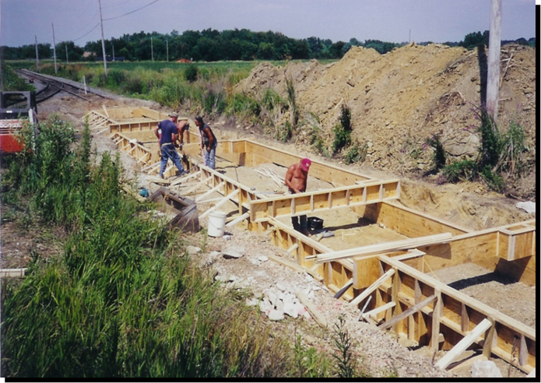
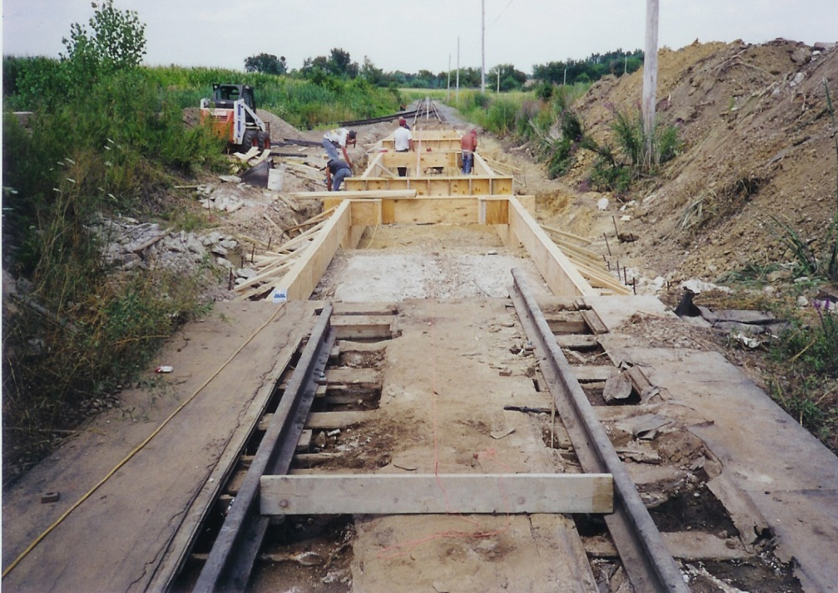
RLP Foundation Requirements
Current AAR guidelines require that the soil bearing capacity under the scale be 4000 PSF. This should be determined before excavation with a qualified geotechnical report, which should also include any ground improvements that may be required.

Slide 4
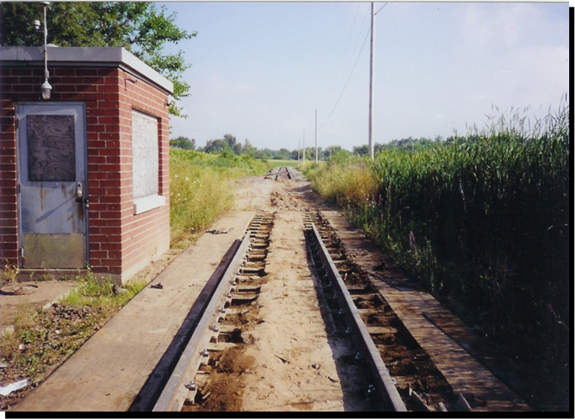
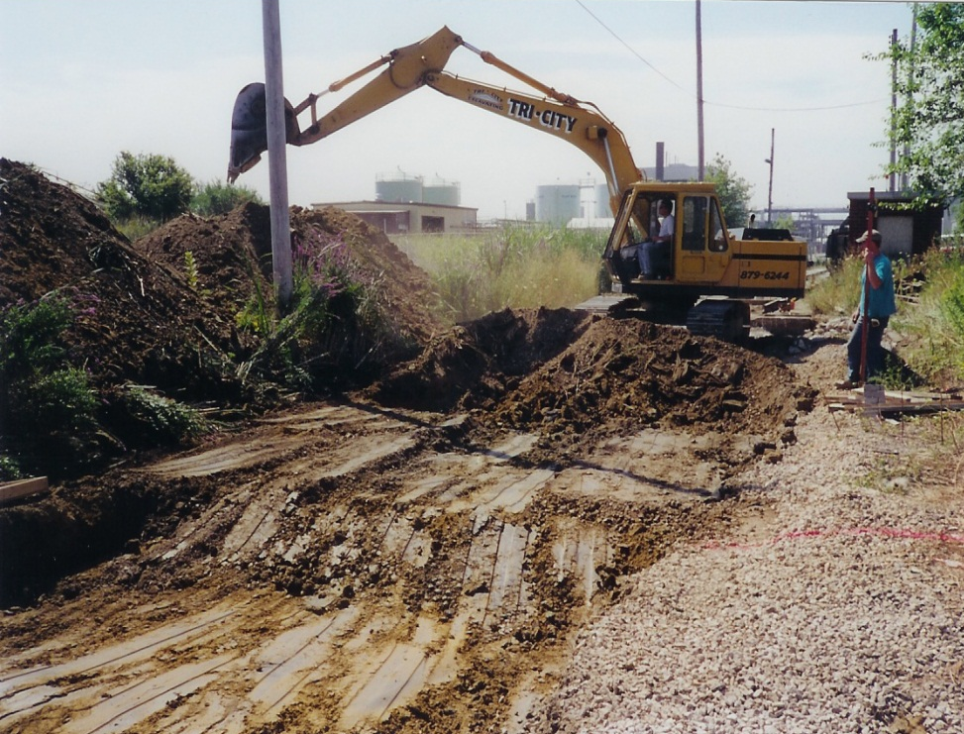
RLP Site Selection and Excavation
AAR Scale Handbook requires there to be 75’ of straight, level tangent track on either side of the 25’ scale approaches. A two draft system requires 50’ approaches on either side of the scale.

Slide 5
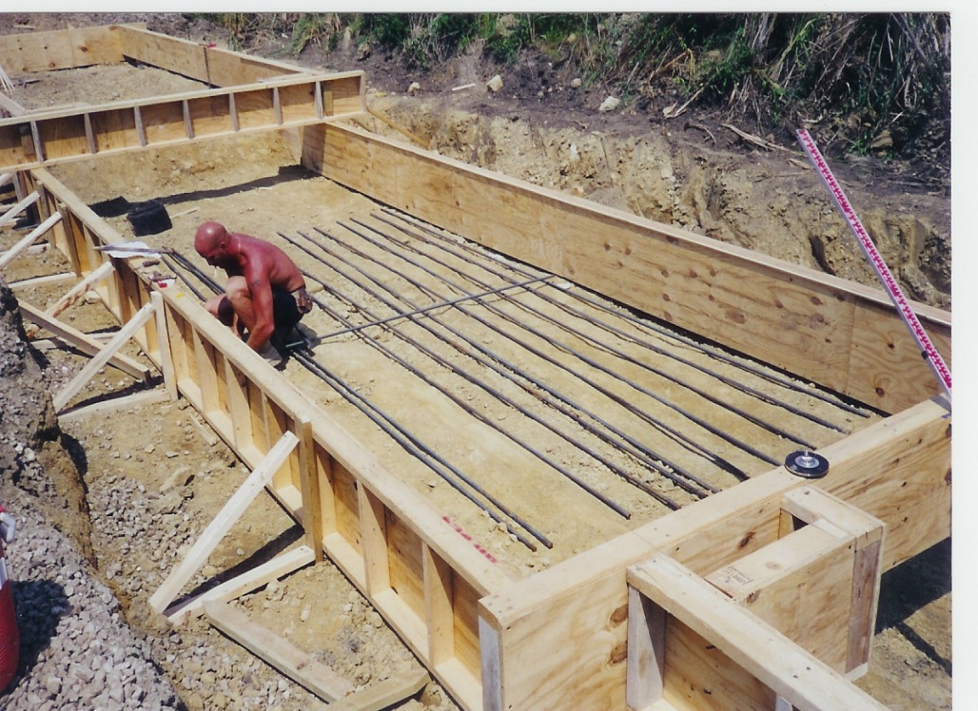
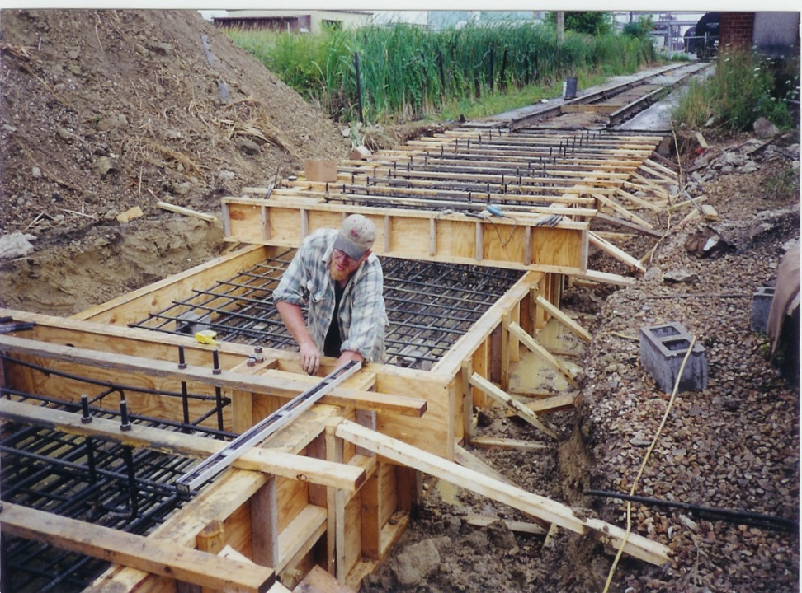
RLP Forming and Rebar Placement
The rebar and concrete schedules can be found on the factory supplied prints. A typical Full Draft system has over 200 anchor bolts.

Slide 6
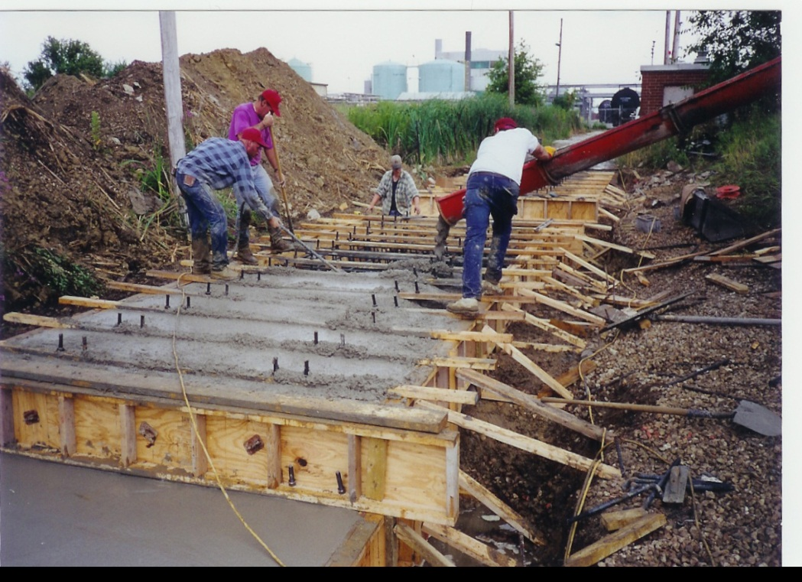
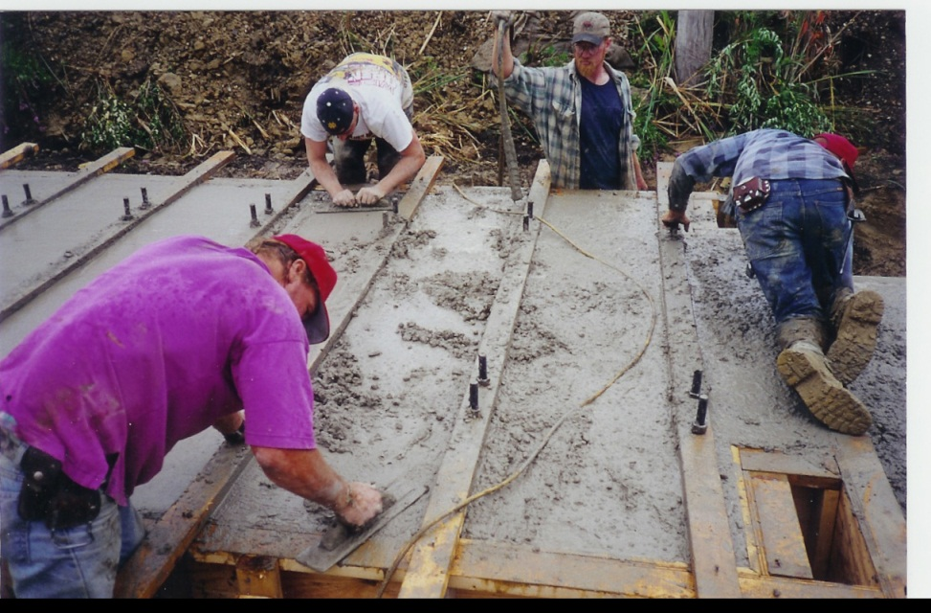
RLP Foundation Pour
Concrete and grout specifications can be found on the factory supplied prints.

Slide 7
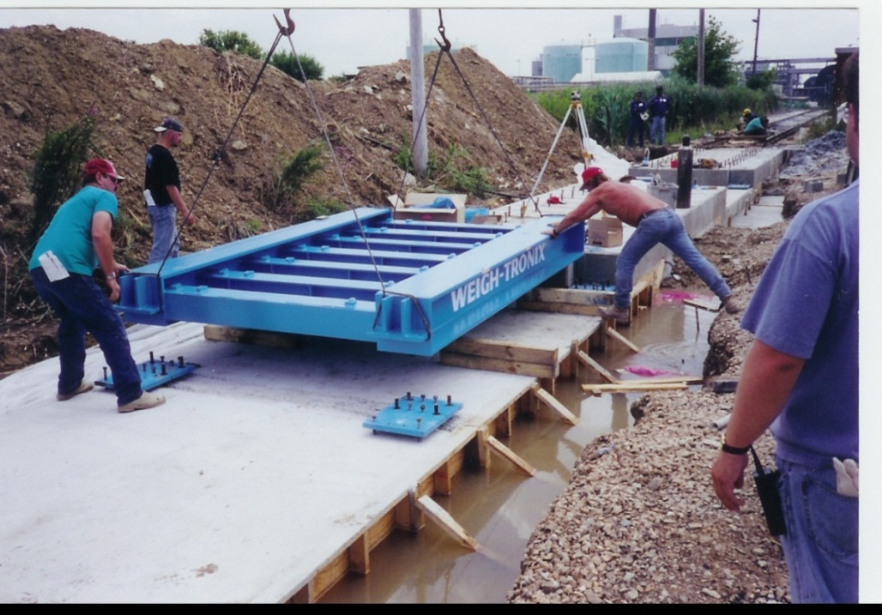
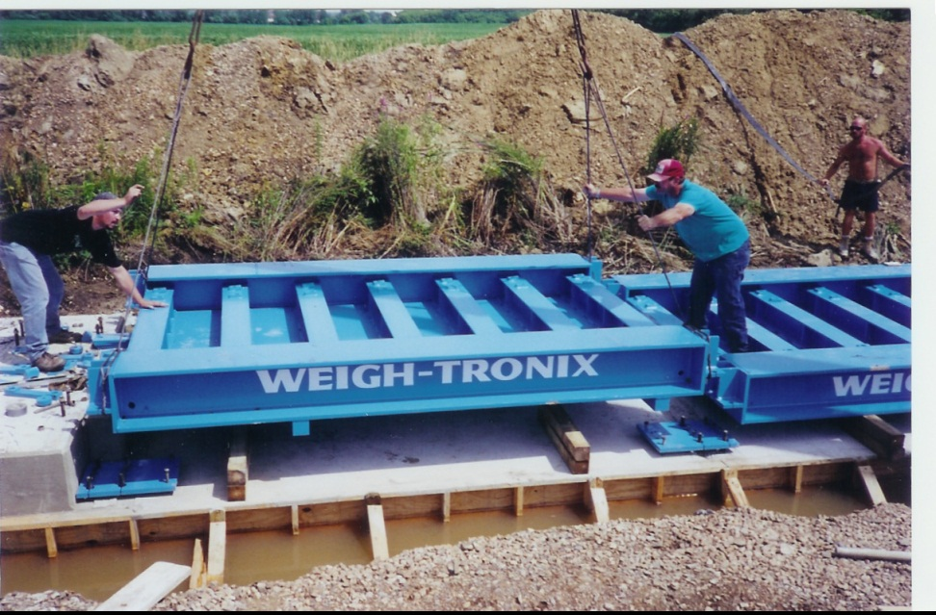
RLP Setting Scale Sections
In setting the scale, it is suggested that load cell “dummies” be installed to protect the load cells from damage. A single module has a shipping weight of over 10k and will require the need for adequate lifting equipment .

Slide 8
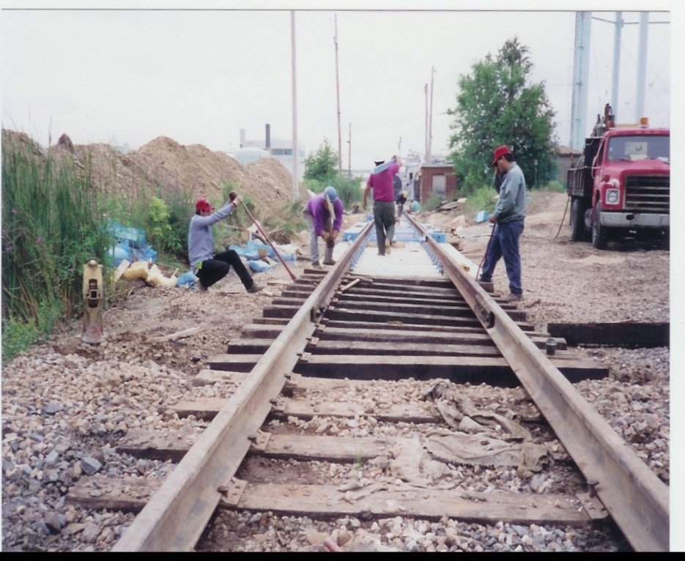
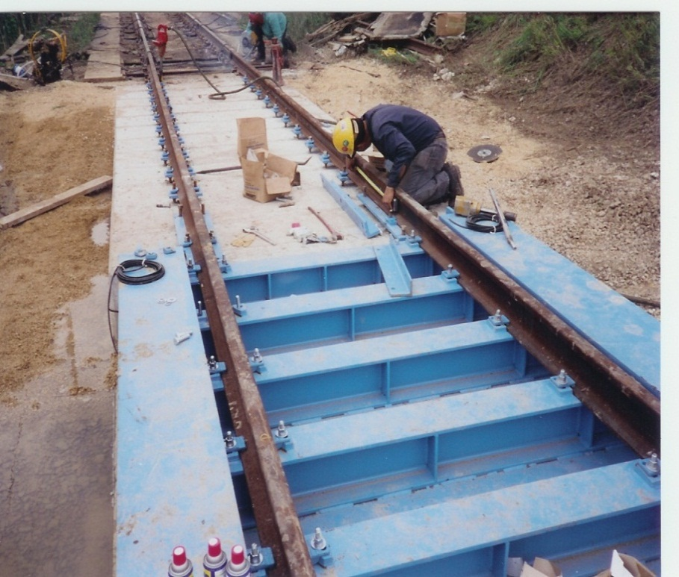
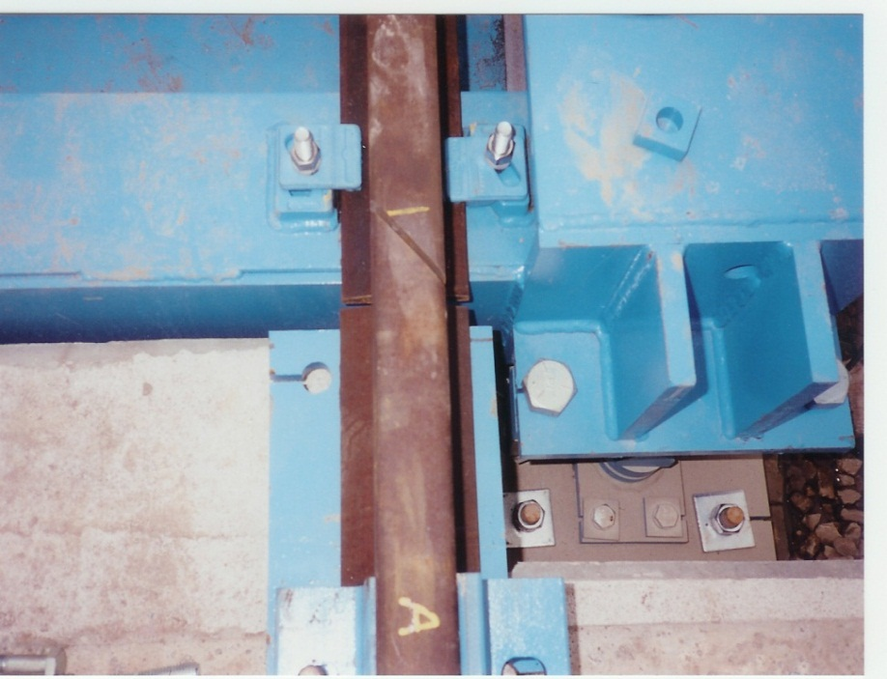
RLP Rail Installation
AAR Handbook requires specific rail mitering and anti-creep hardware to be installed. This will need to be completed by a separate “Rail Contractor”.

Slide 9
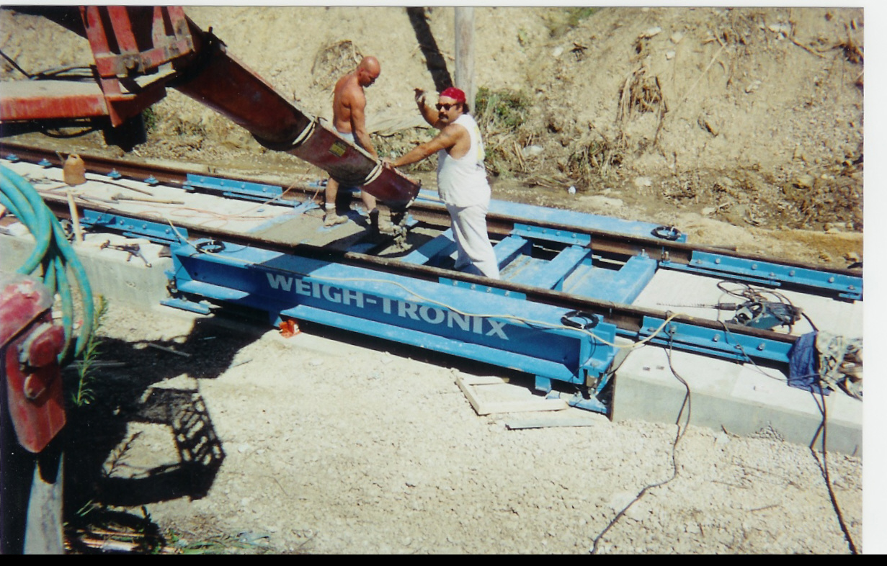
RLP Deck and Ballast Pour
Depending on the model, the deck will either be flush or standard. Both models include a concrete deck finish that also serves as added ballast and increases the overall scale weight.

Slide 10
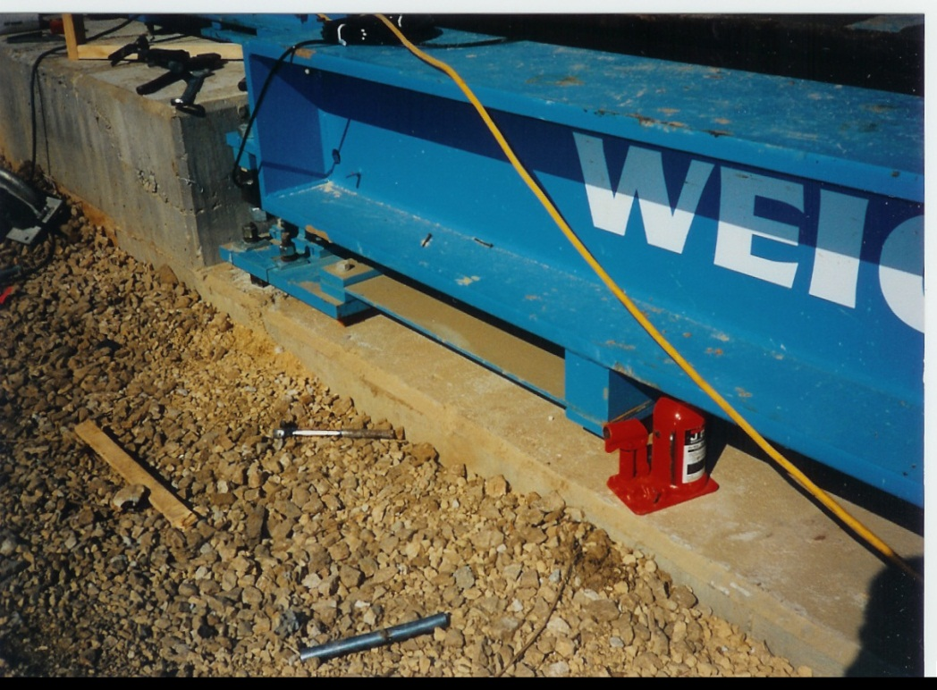
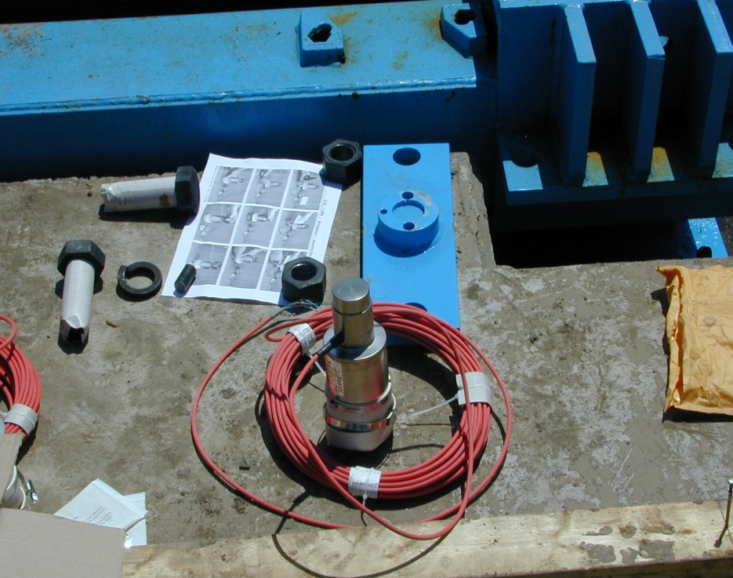
RLP Checking and Load Cells
The RLP uses a rigid checking system and Stainless Steel “Rocker Column” load cells.

Slide 11
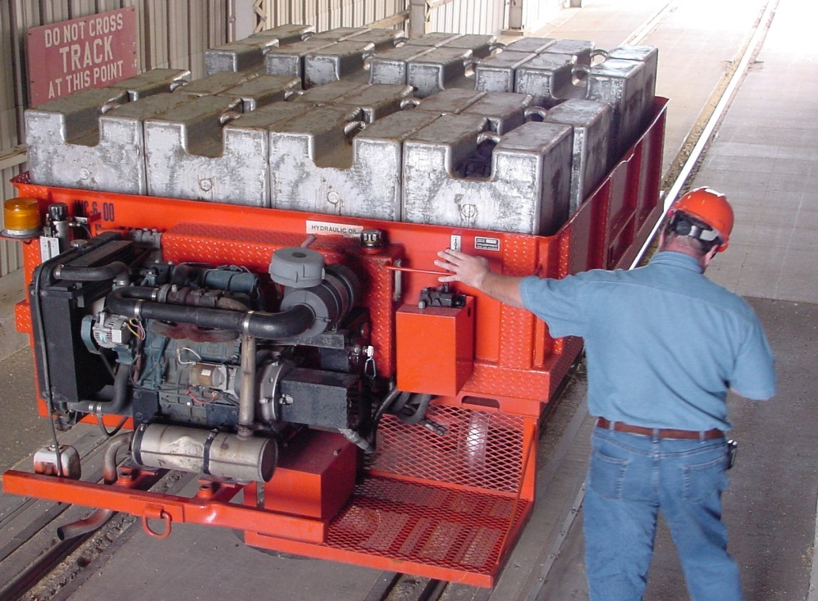
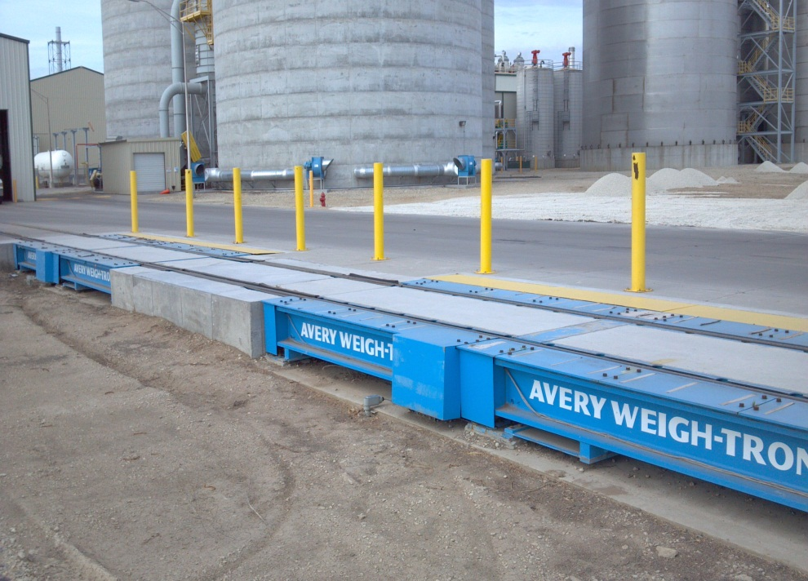
RLP Completion and Calibration
No less than 80,000 lb. (36,300 kg) may be used for track scale certification except for Interim Approval (returning a scale temporarily to service after repairs). It is highly recommended to check with the local governing body for further requirements.

